Slide 1
Domotics
Home robotics for fun and profit

Slide 2
Definitions
The Internet of things (or IoT) is the internetworking of physical devices, vehicles (also referred to as "connected devices" and "smart devices"), buildings, and other items—embedded with electronics, software, sensors, actuators, and network connectivity that enable these objects to collect and exchange data
Domotics - Home automation or smart home (also known as domotica) is the residential extension of building automation and involves the control and automation of lighting, heating (such as smart thermostats), ventilation, air conditioning (HVAC), and security, as well as home appliances such as washer/dryers, ovens or refrigerators/freezers that use WiFi for remote monitoring. Modern systems generally consist of switches and sensors connected to a central hub sometimes called a "gateway" from which the system is controlled with a user interface that is interacted either with a wall-mounted terminal, mobile phone software, tablet computer or a web interface, often but not always via internet cloud services.
Notes:
Mention Nest Learning Thermostat showing weather's impact on energy usage.

Slide 3
Initial inspiration
The House that Bob Built (1990) Synopsis - Looks at the house adapted by Bob Symes in Milton Keynes to improve on its space and design, for wiring, insulation, water and low-cost energy techniques long used by the Germans and Scandinavians - all to show up the inadequacies of the design of British homes from such viewpoints.
Oregon Scientific radio controlled weather station - bar688hg (2004)
Temperature and Humidity sensors
External to house (Porch, Loft and back door)

Slide 4
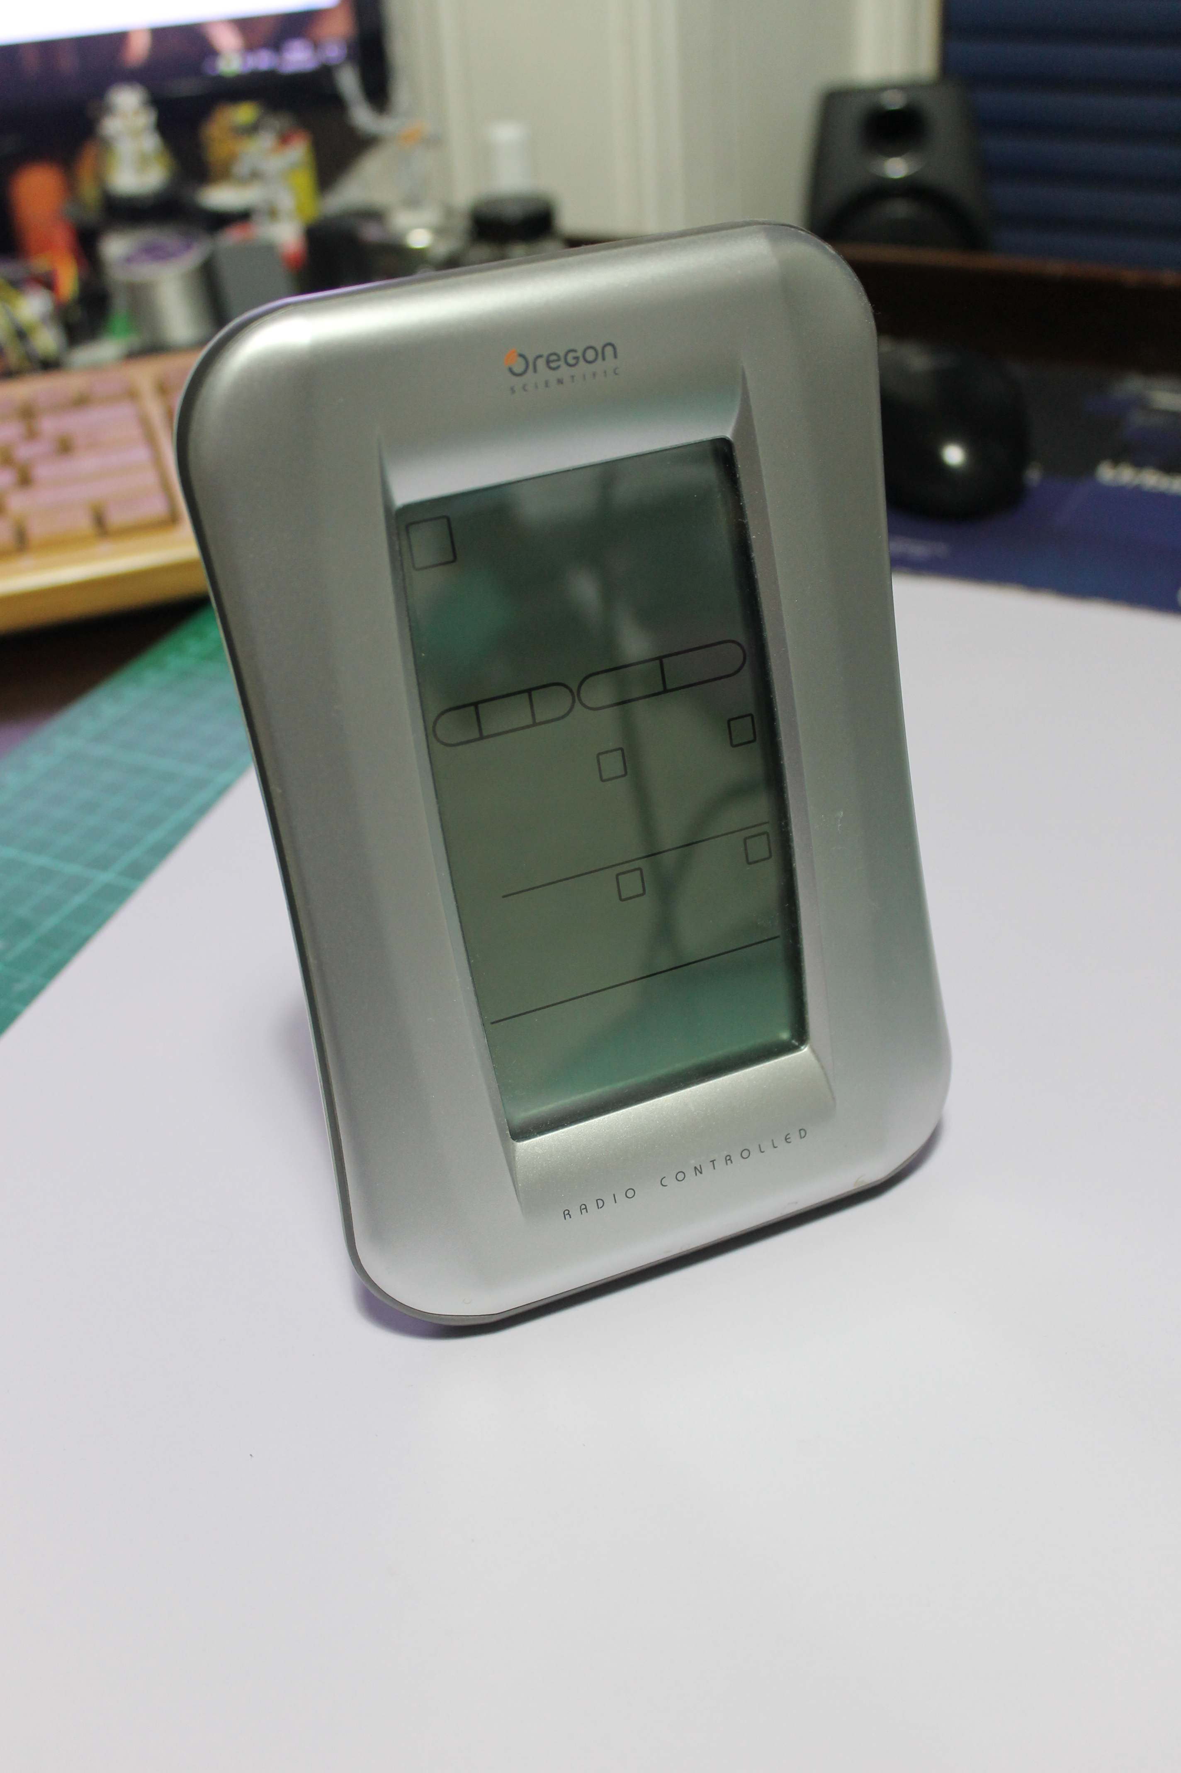
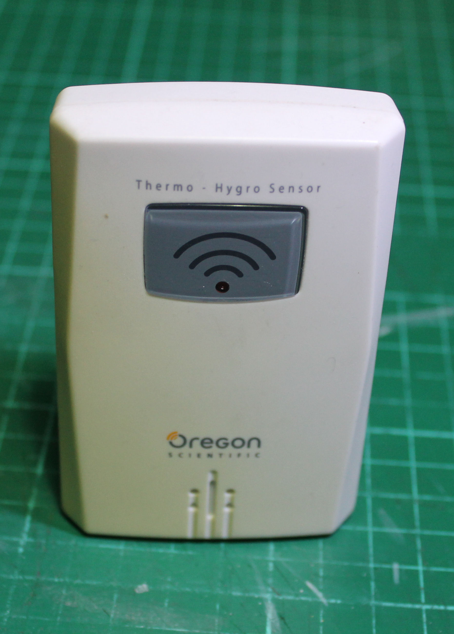
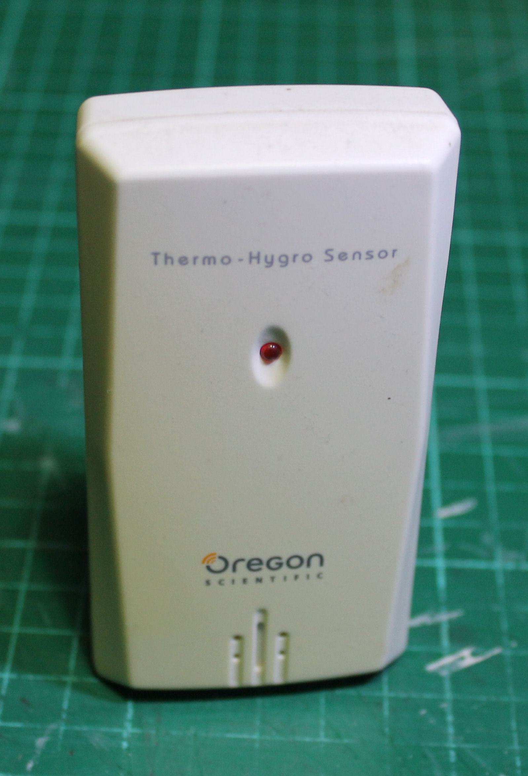
Oregon Weather station + sensors

Slide 5
Objectives
Cut heating costs
Discover possible humidity spikes in the house
Restore external weather sensors
Data gathering
Fun

Slide 6
Impediments to development (2005)
Cost
Electronic complexity
Lack of suitable Software
Thick walls

Slide 7
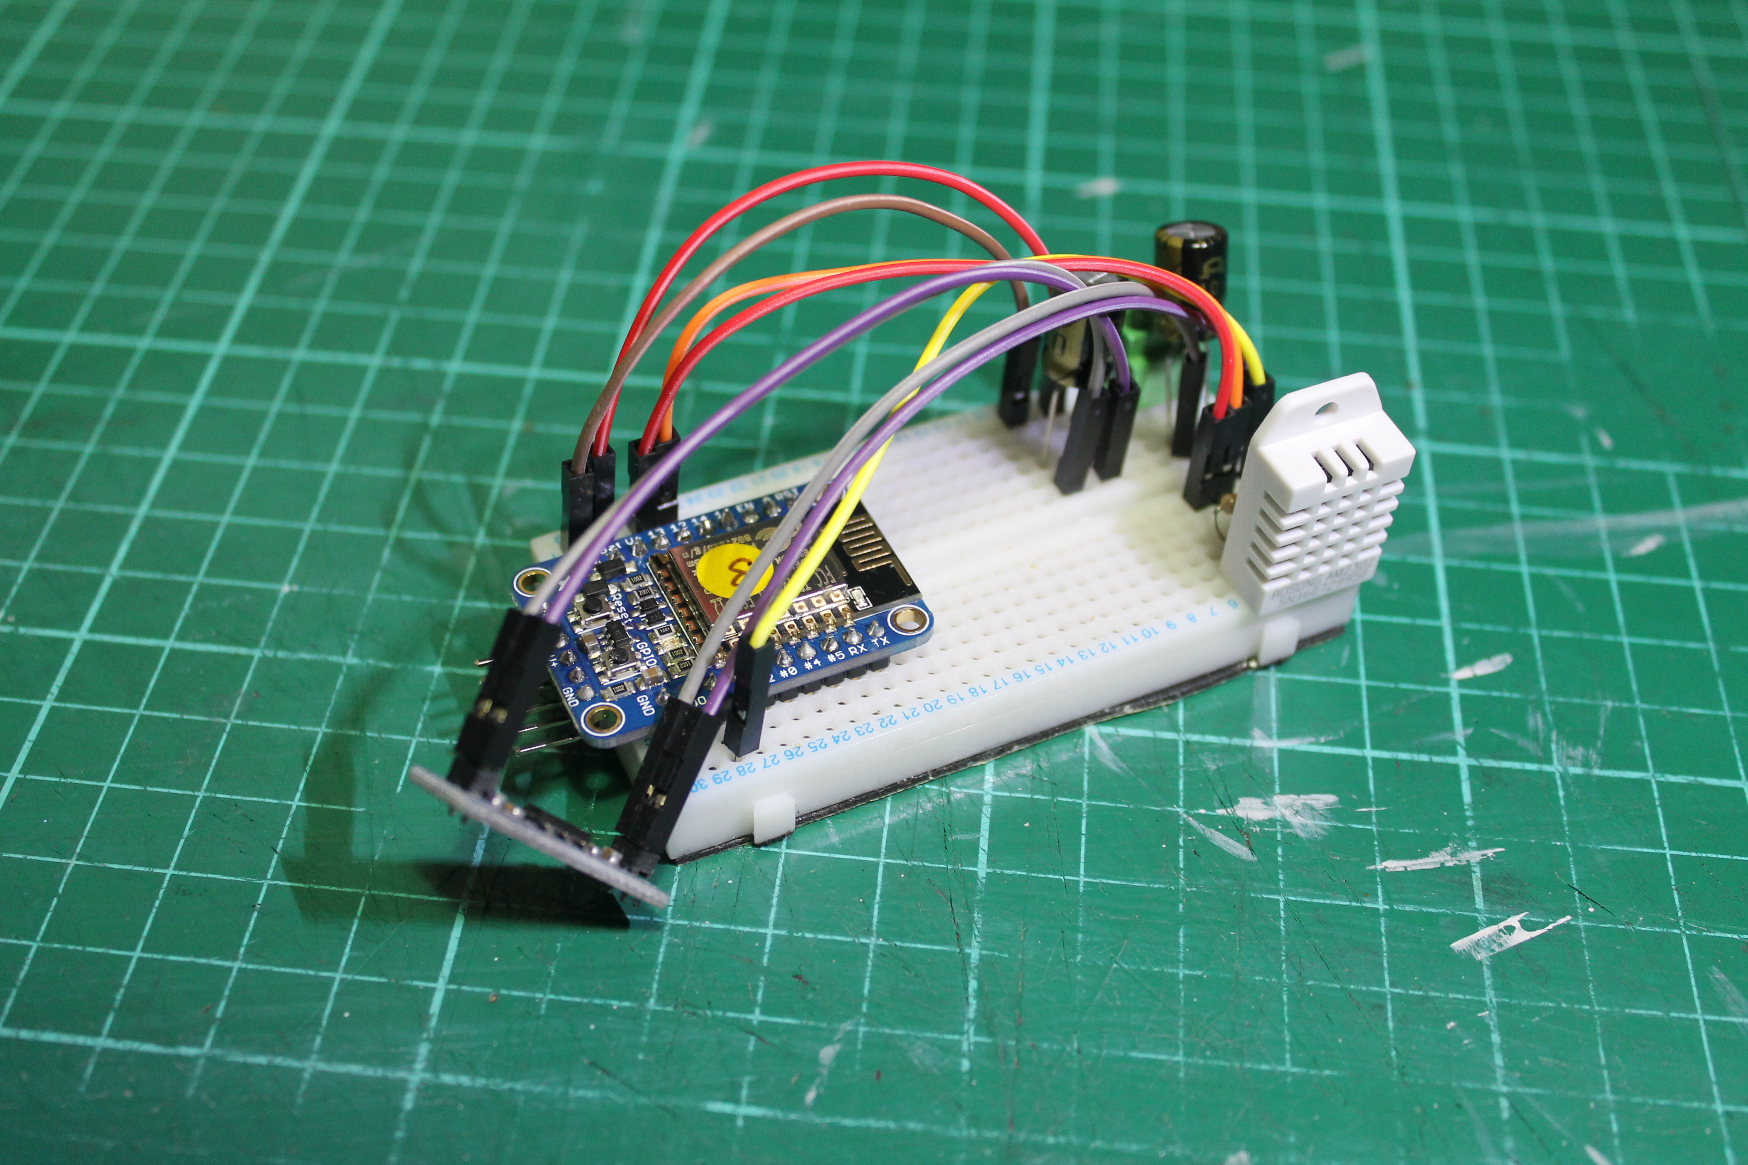
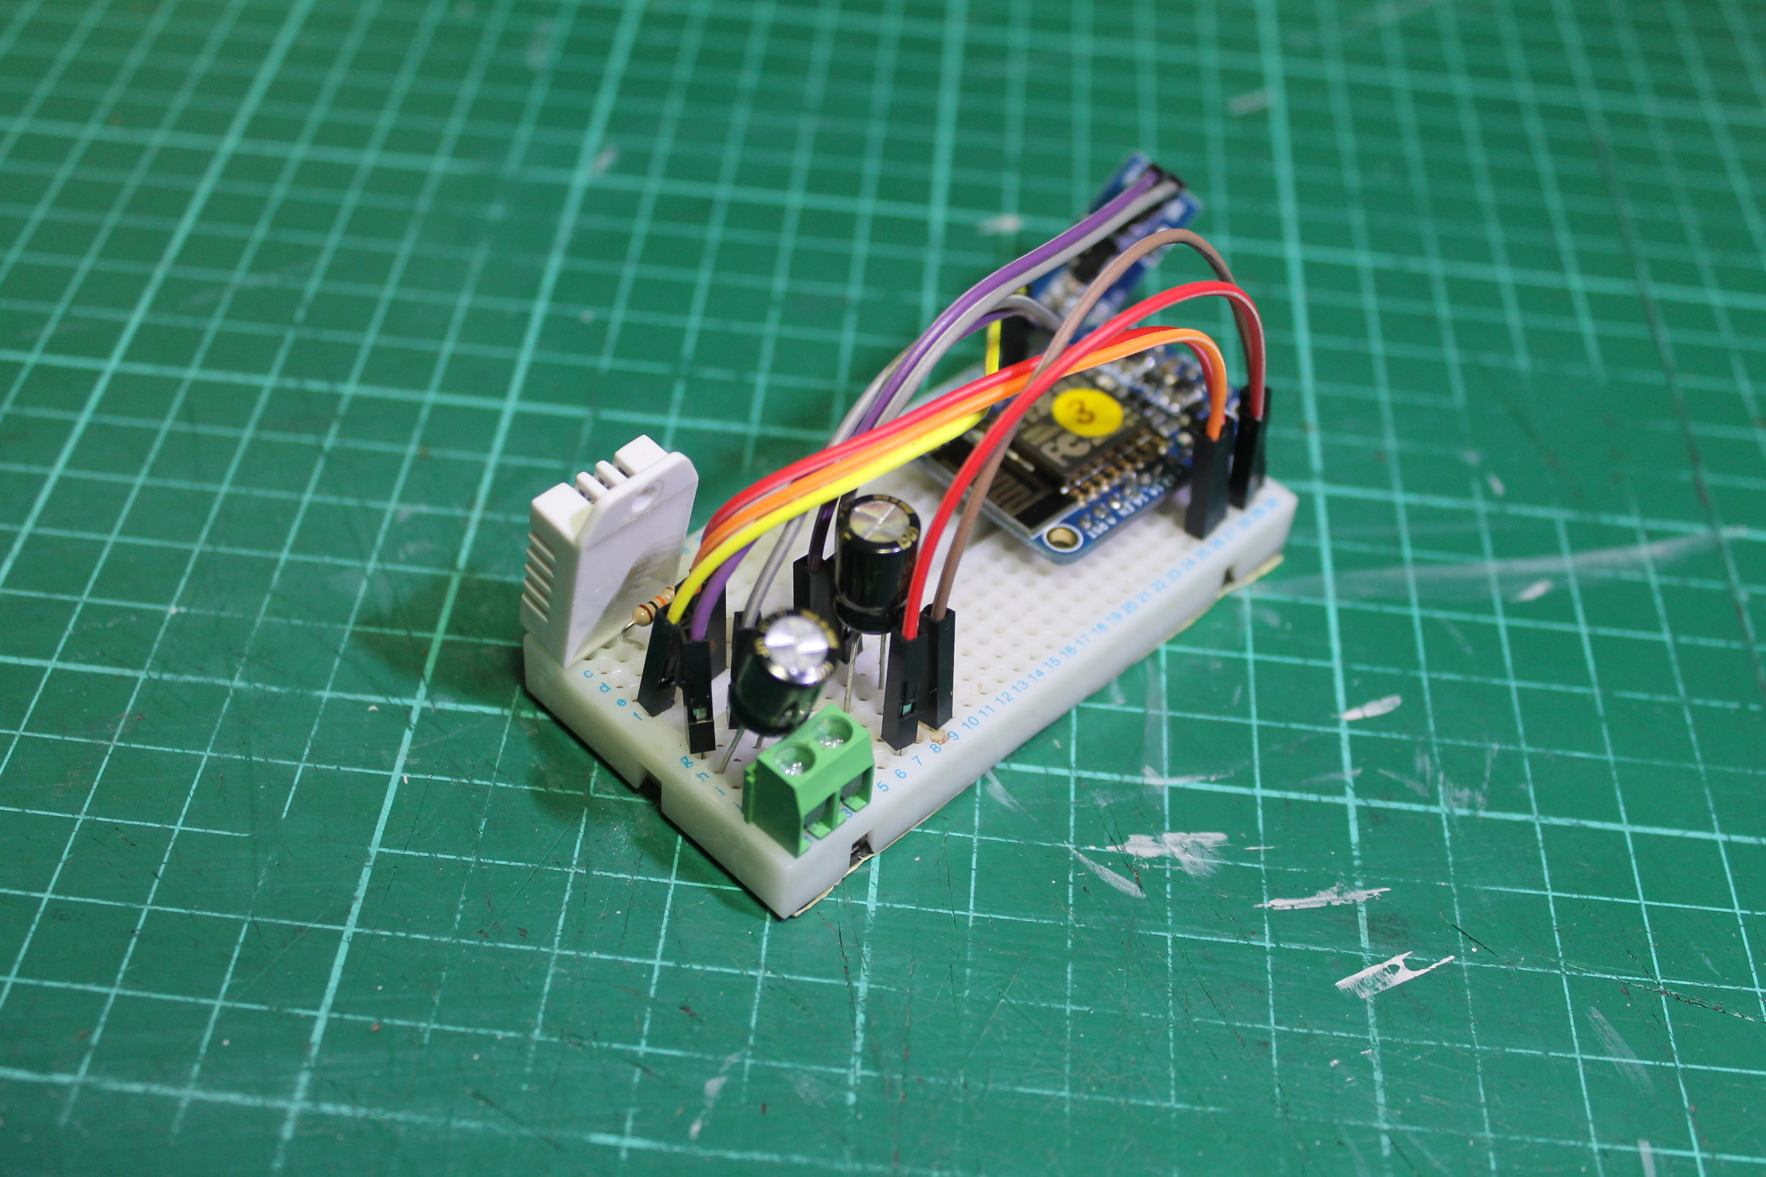
Start of Development 2015
Hardware
DHT11 v DHT22
Wired v WiFi
Arduino Uno v Arduino Nano
ESP8266

Slide 8
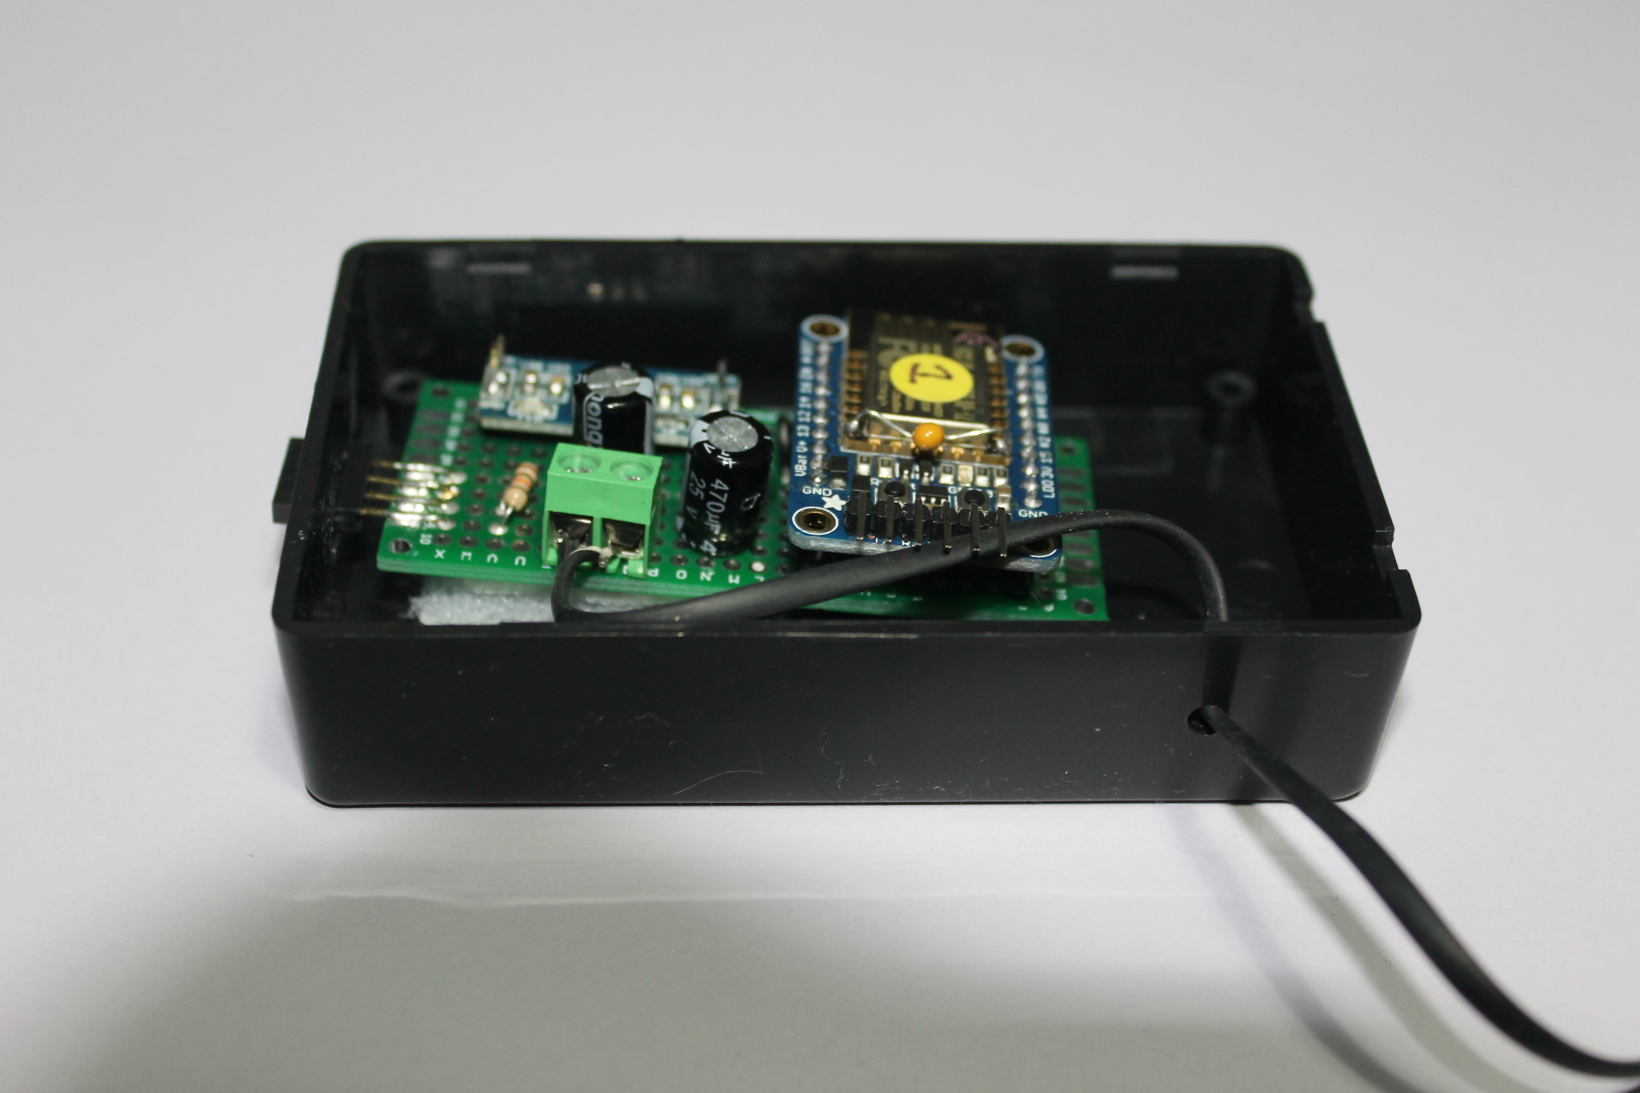
The finished sensor

Slide 9
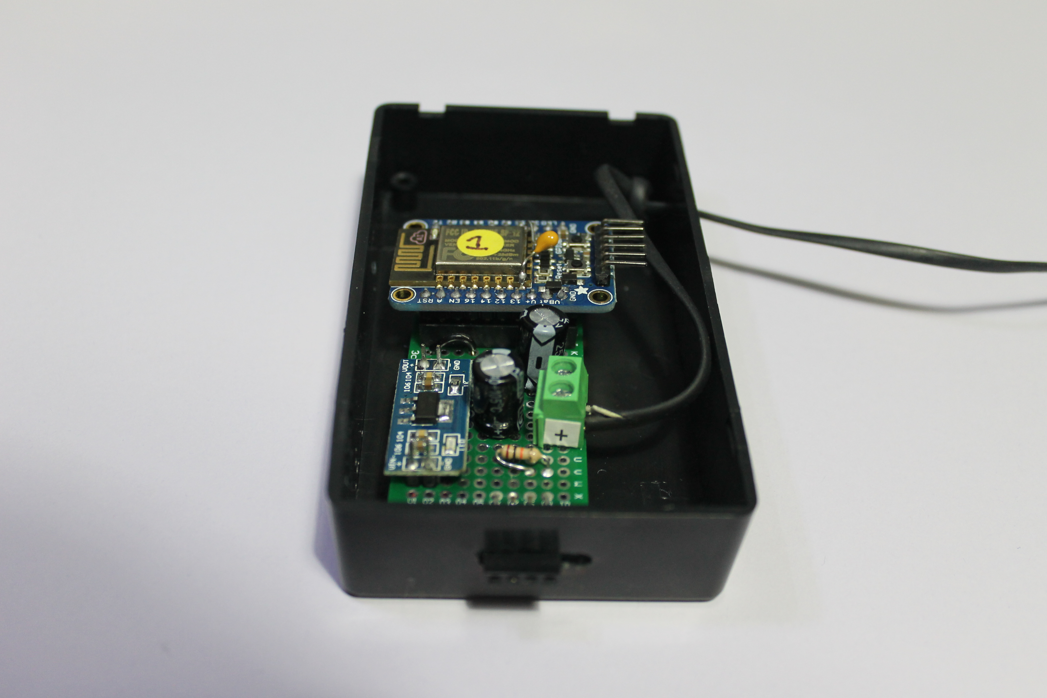

Slide 10
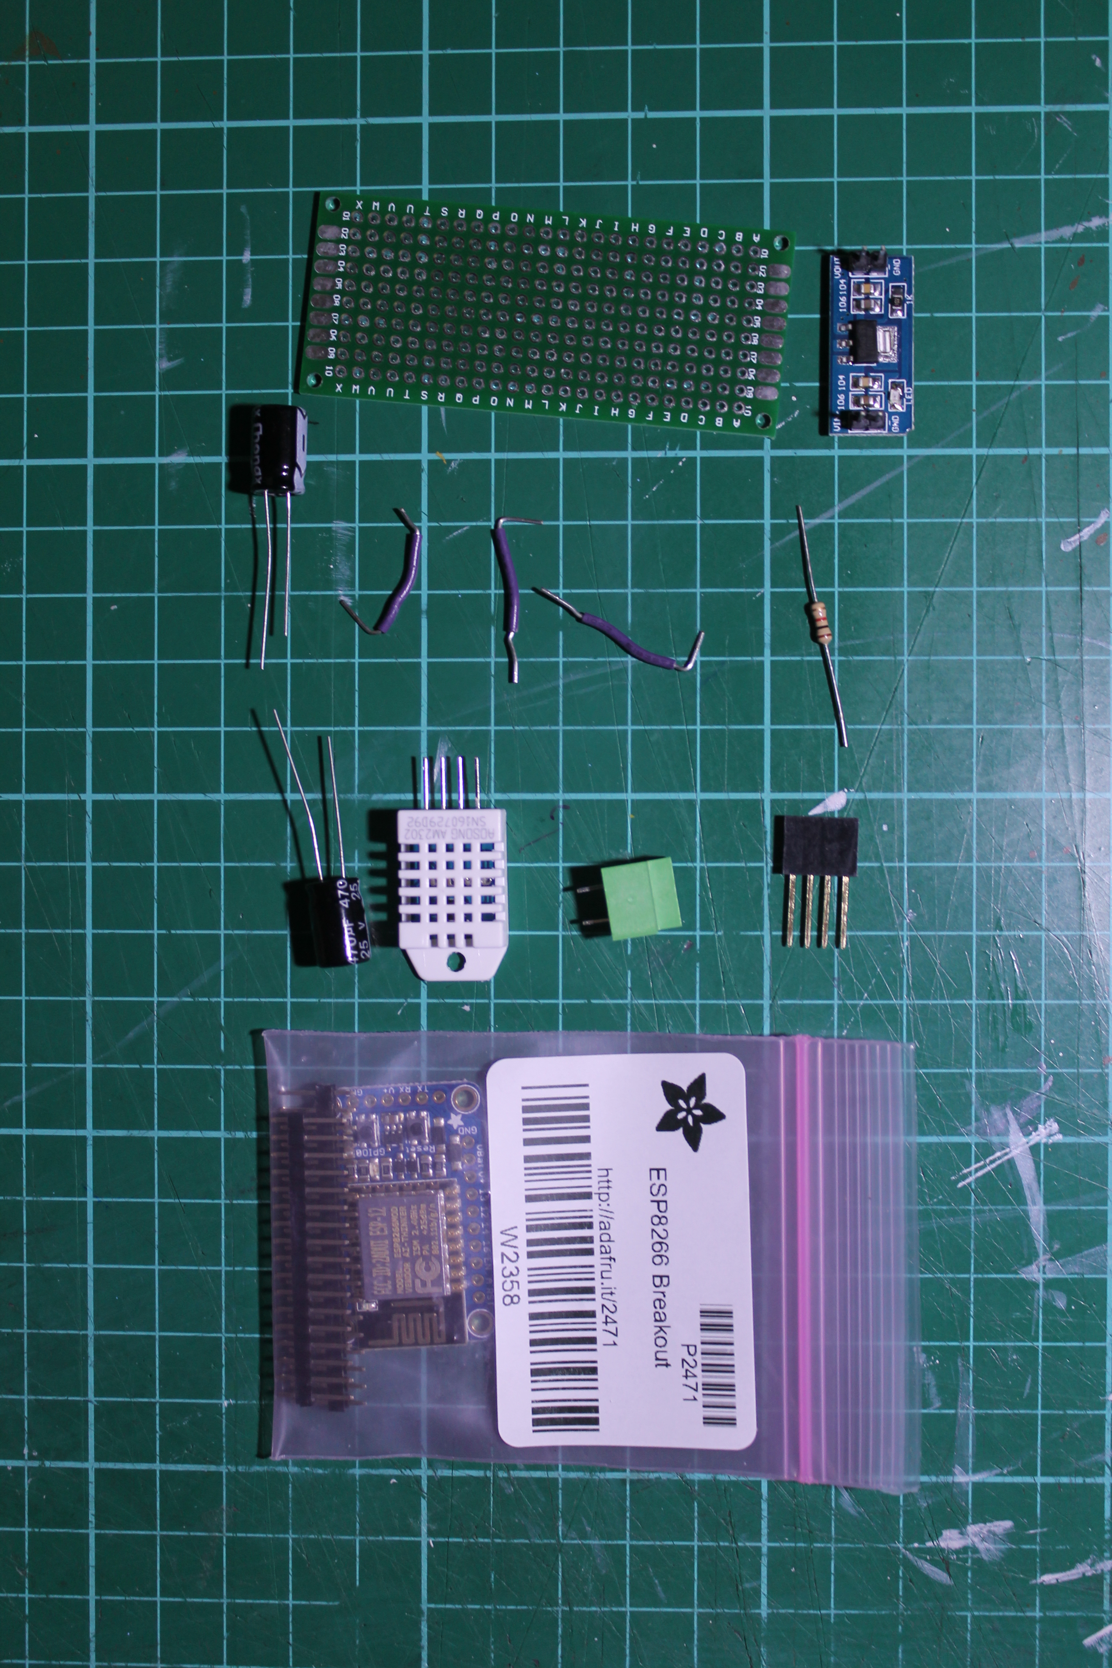
Hardware costs : The components

Slide 11
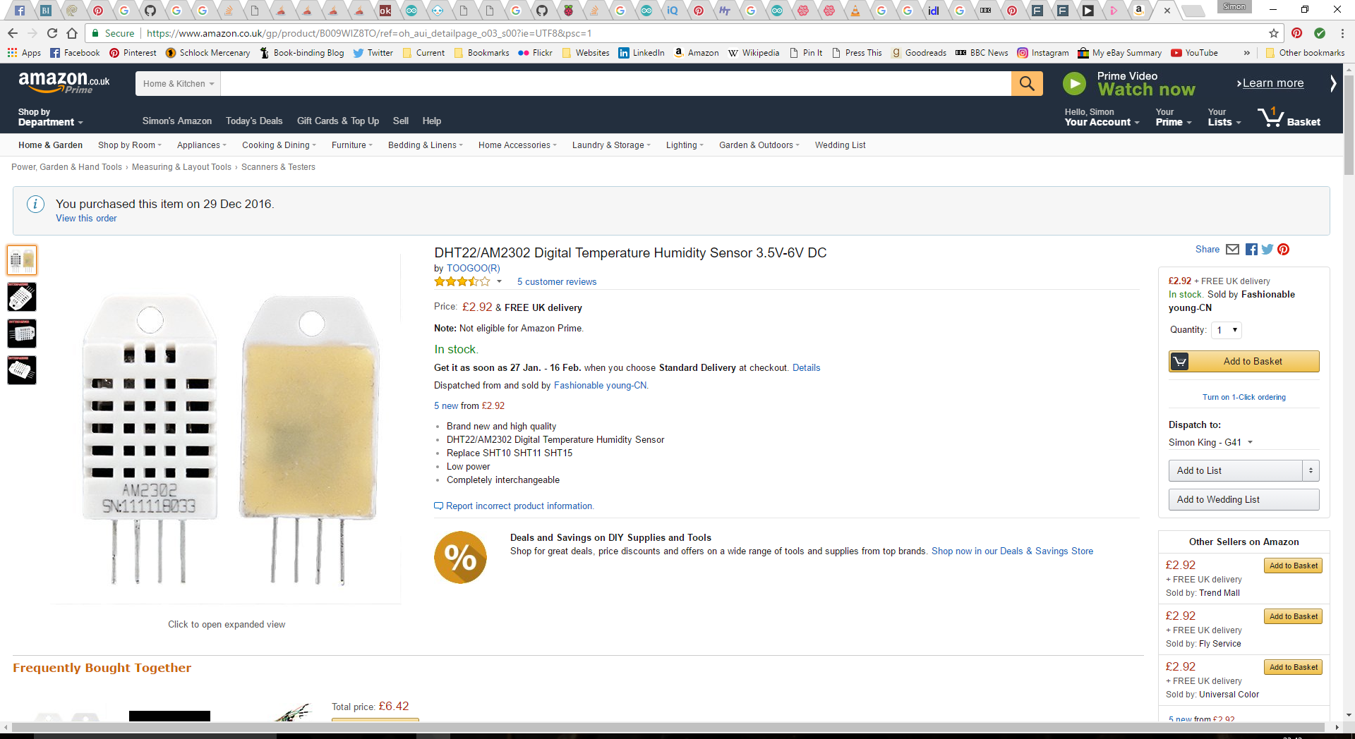

Slide 12
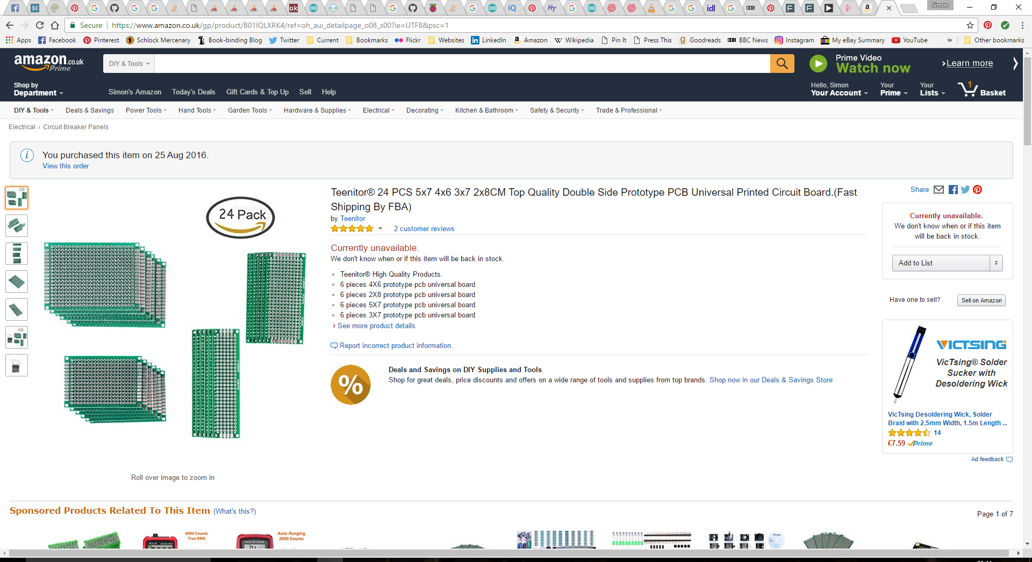

Slide 13
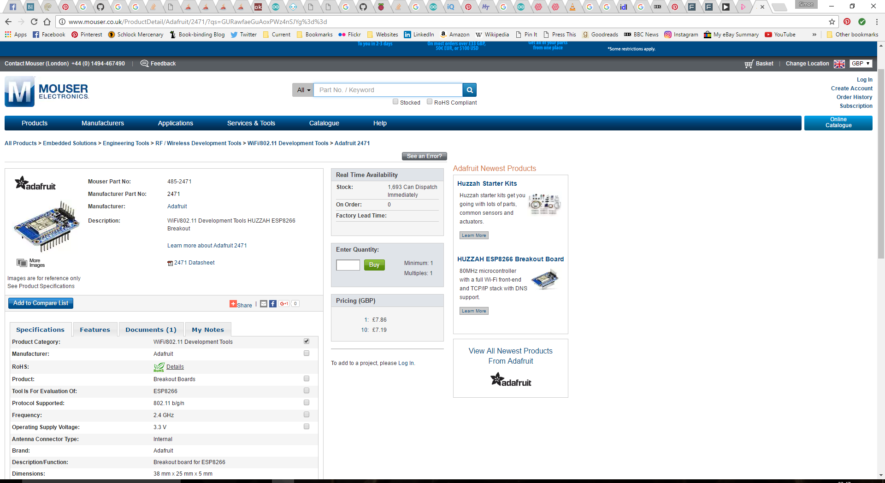

Slide 14
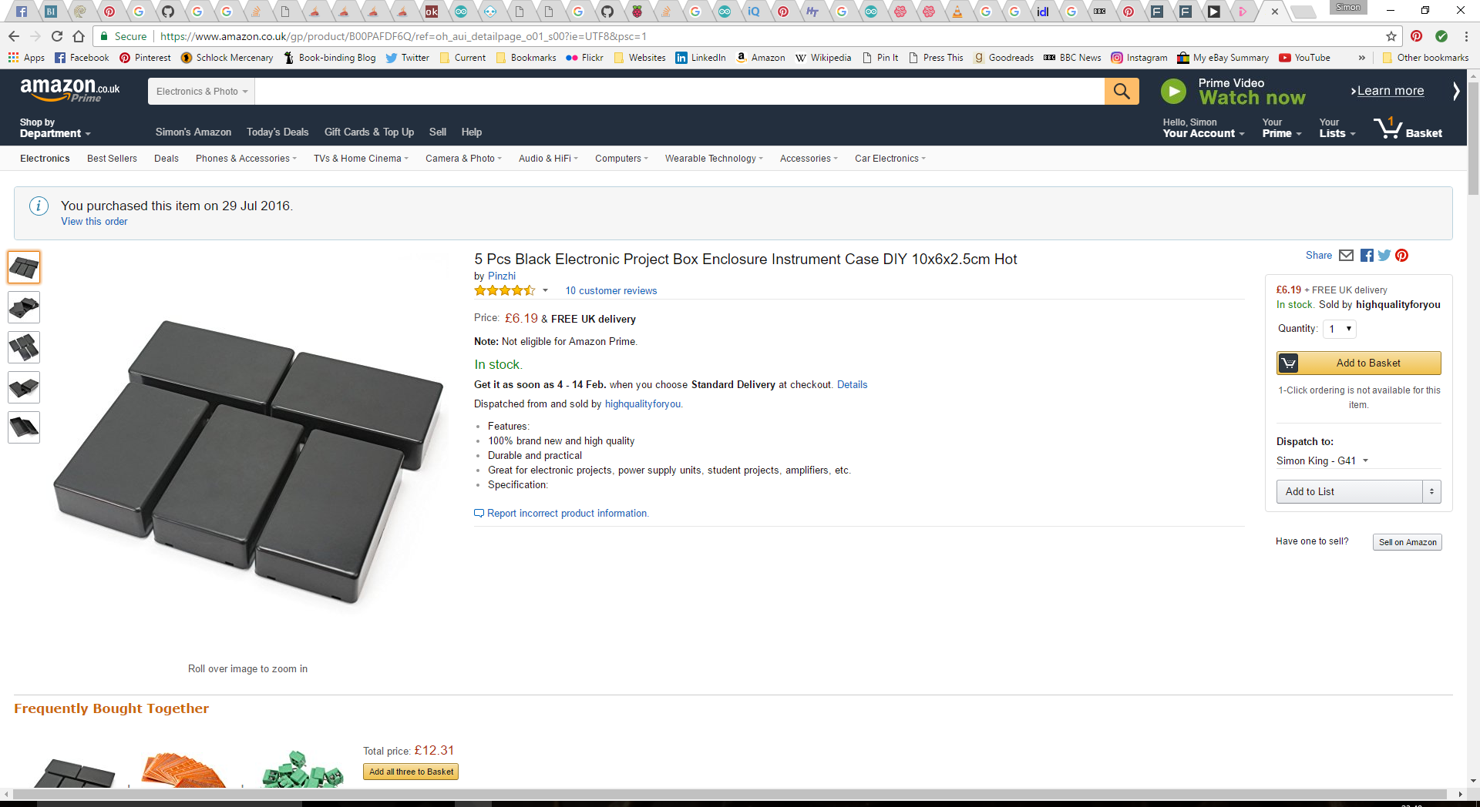

Slide 15
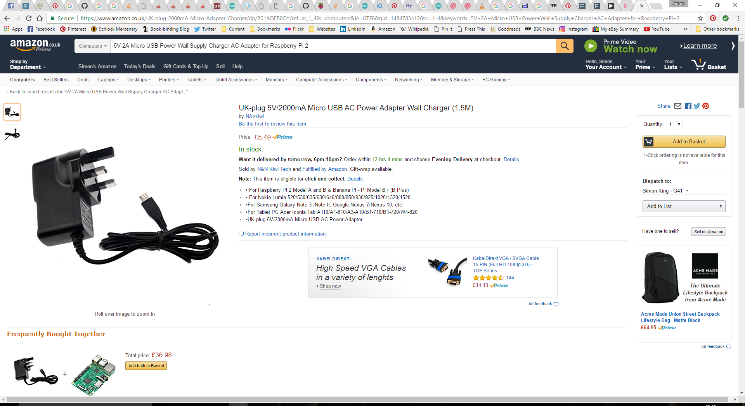

Slide 16
Approximate cost
£22

Slide 17
Software
Spring Boot with Tomcat
Angular2 - TypeScript
ChartJS with ng2-charts

